Slide 1
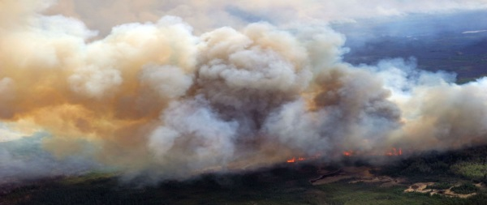
Fire Emissions and Smoke Management Plans
Current Work of the WRAP Fire and Smoke Workgroup (FSWG) and the Representative Baseline and Future Fire Scenarios Workgroup (RBFFS)
Workgroup Co-chairs:
Sara Strachan, Idaho DEQ
Bob Kotchenruther, EPA Region 10
Paul Corrigan, USDA and State of Utah
Contractor:
Matt Mavko, Air Sciences, Inc.

Slide 2
Summary of Current Work
Development of:
5-year representative baseline wildfire emissions inventory for input to regional haze modeling
Future fire scenarios wildfire emissions inventory for input to regional haze modeling
Map-based informational portal to Smoke Management Plan/Program information for states and tribes

Slide 3
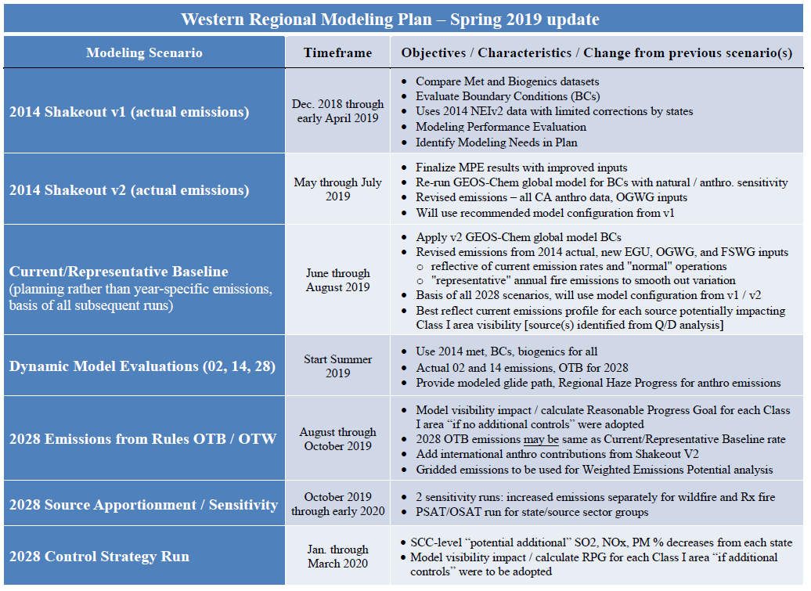
Representative Baseline Fire EI
Regional haze modeling requires representative baseline planning emissions that best reflect the current emissions profile for each source potentially impacting Class I Area visibility.

Slide 4
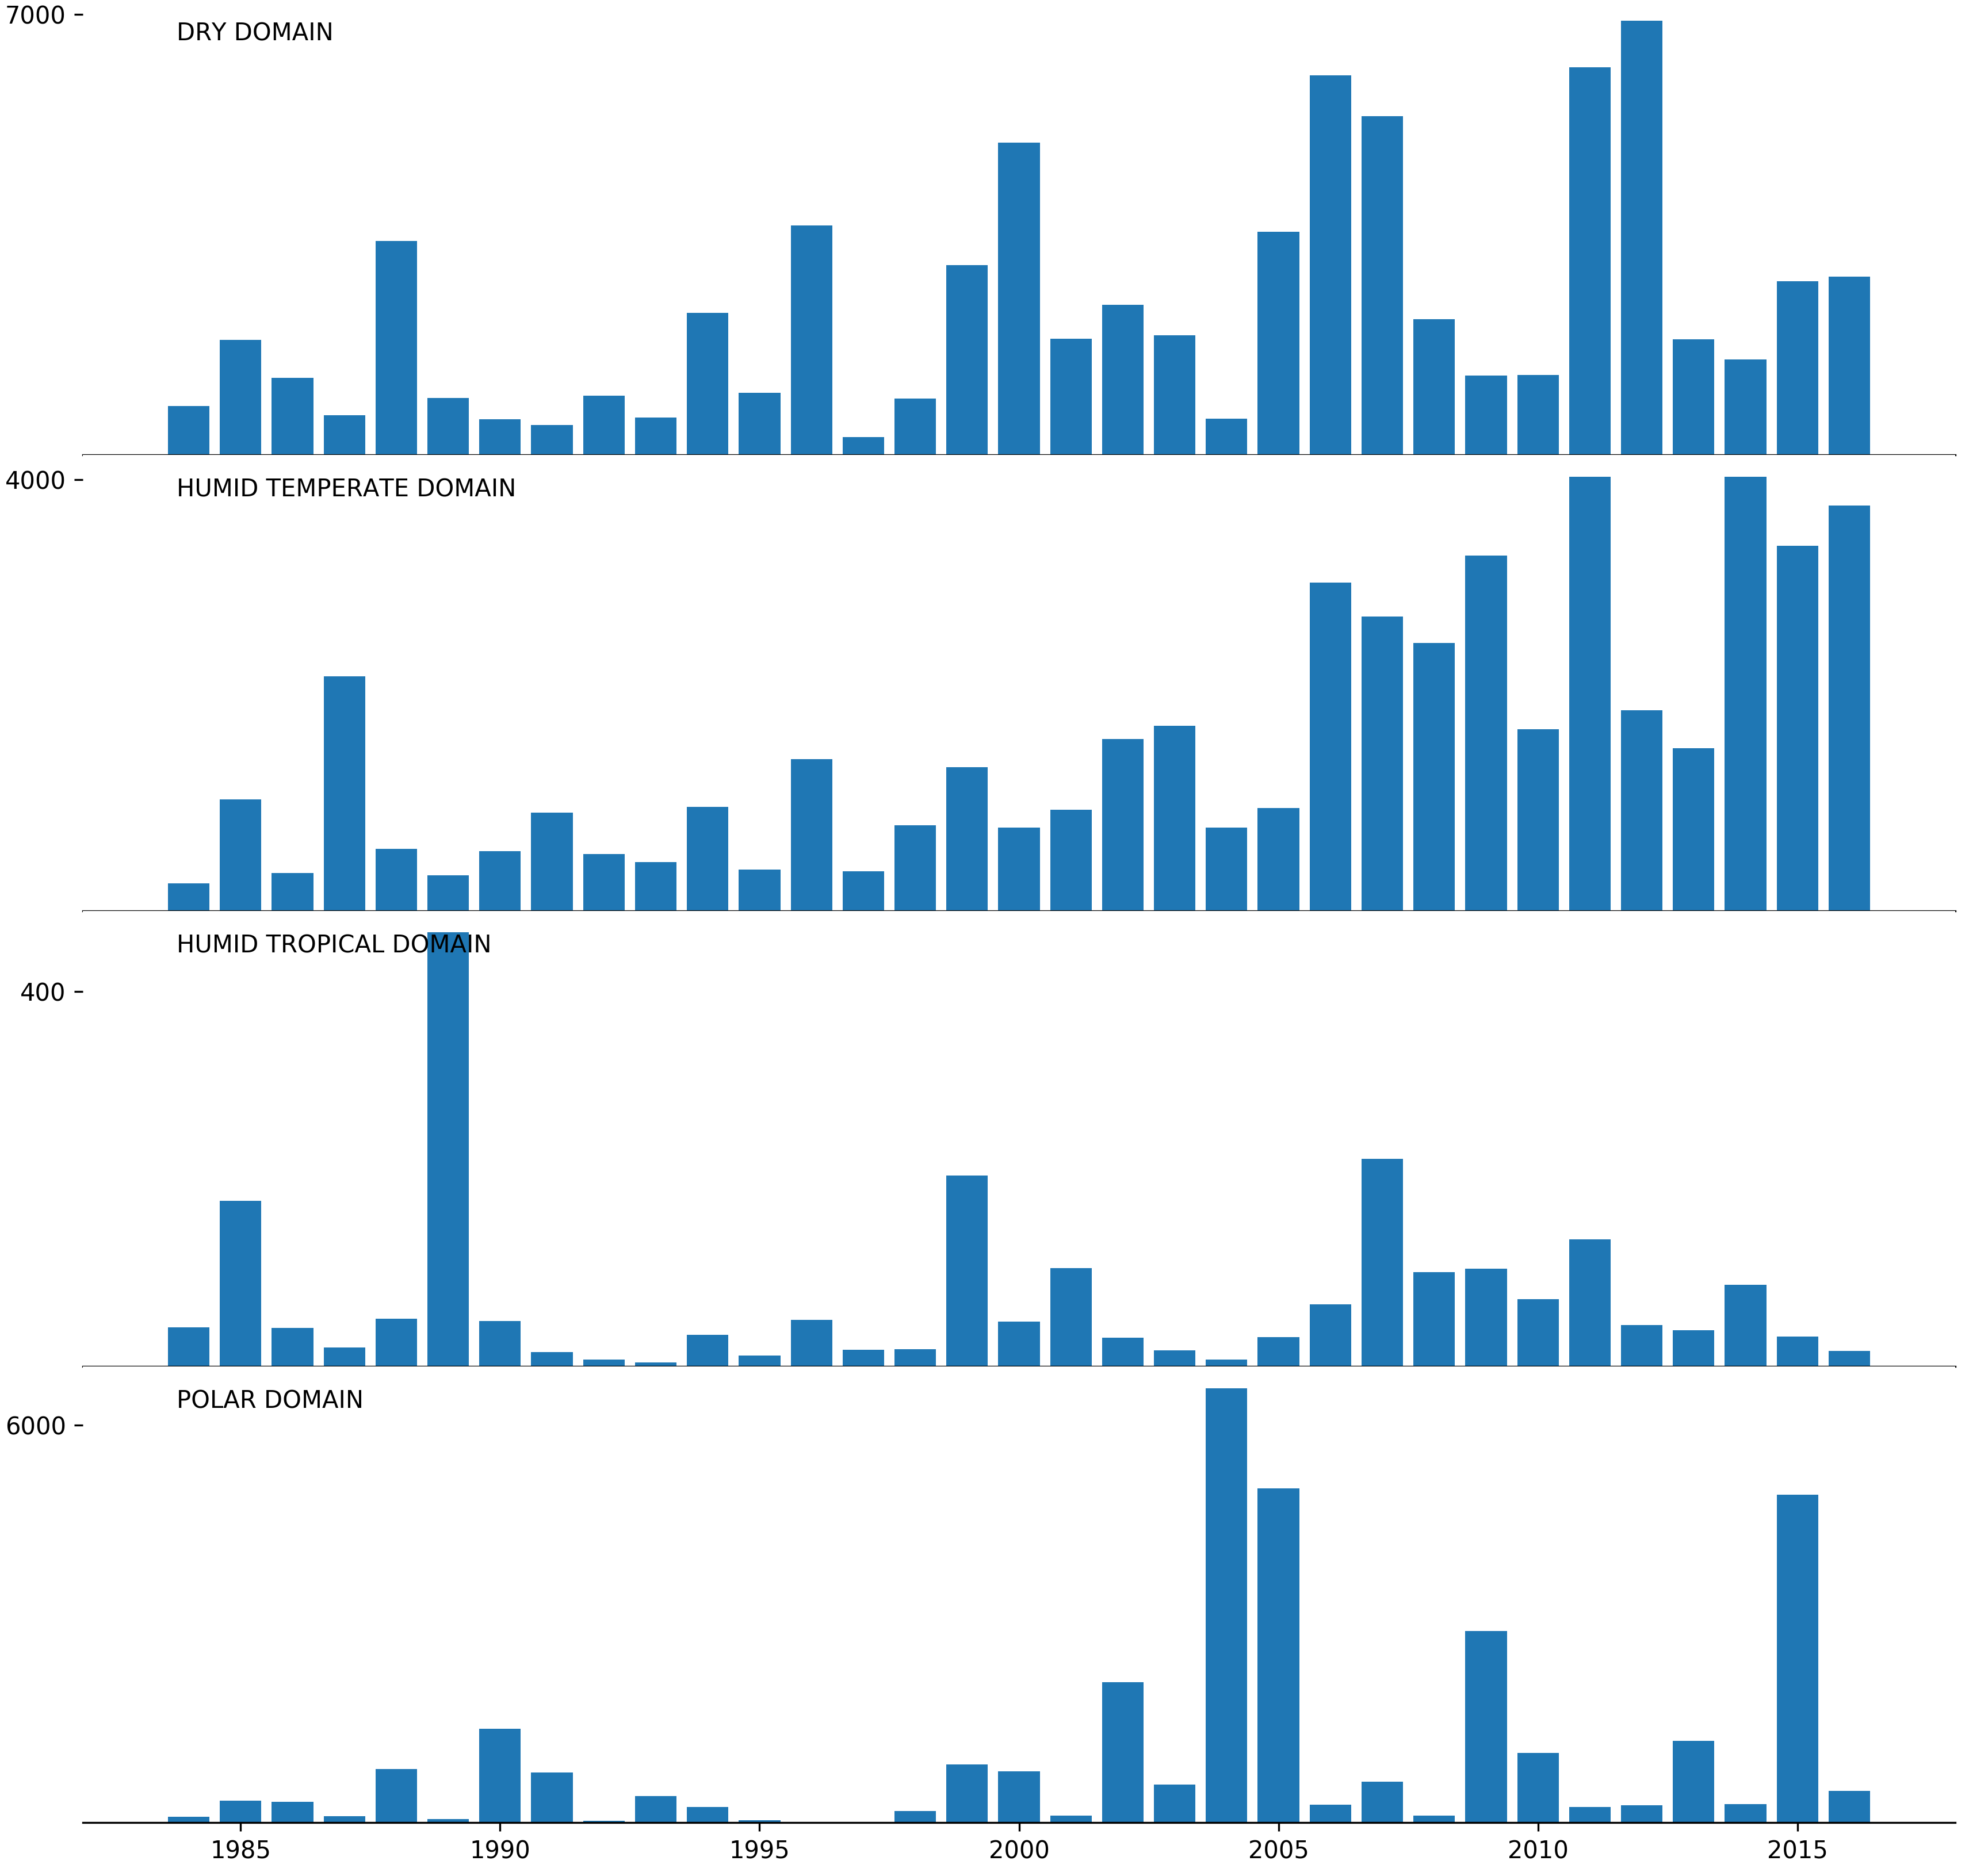
Representative Baseline Fire EI
MTBS WF Acres Burned (1984-2016)
As a source, wildfire has high annual variability in frequency, magnitude, and location.
Total Area (10³ Acres)

Slide 5
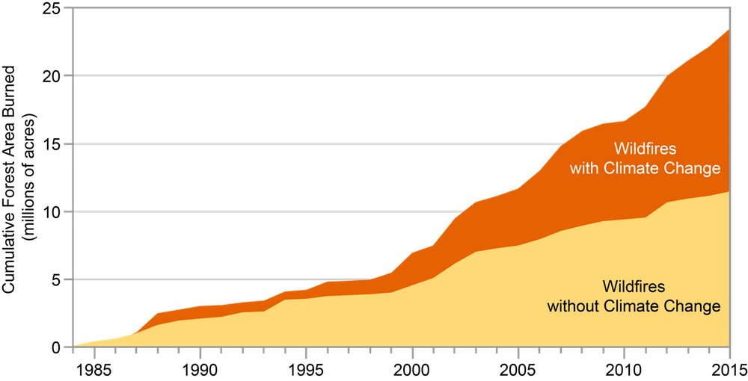
Representative Baseline Fire EI
Annual area burned has been increasing due to climate change and forest management.
Using one year (e.g. 2014 base year) is not representative of variability.
Existing fire inventories for recent 5-year period are lacking.
Reference #99 in USGCRP, 2018: Impacts, Risks, and Adaptation in the United States: Fourth National Climate Assessment, Volume II [Reidmiller, D.R., C.W. Avery, D.R. Easterling, K.E. Kunkel, K.L.M. Lewis, T.K. Maycock, and B.C. Stewart (eds.)]. U.S. Global Change Research Program, Washington, DC, USA, 1515 pp.

Slide 6
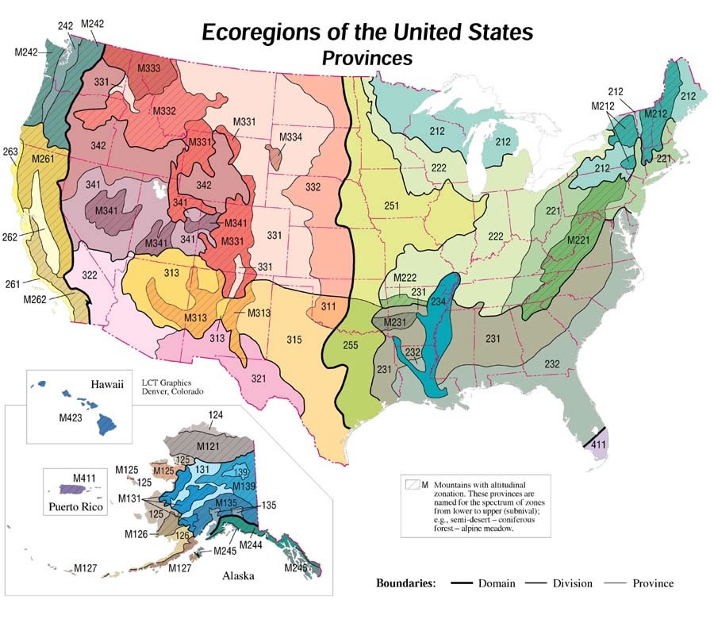
Representative Baseline Fire EI
Decided to build a baseline inventory using a new method based on physical and biological ecoregions.
The approach takes into account fire variability in time, space, and size, while addressing the existence of differing fire regimes and their dependence on feedbacks between fire weather, climate, and fuels.

Slide 7
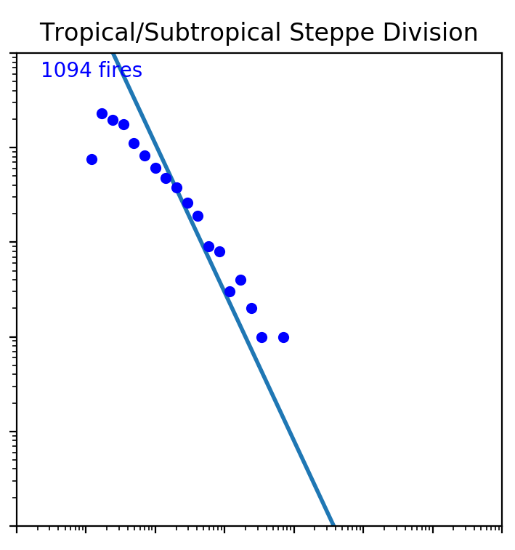
Representative Baseline Fire EI – Wildfire Workflow
Round 1 (Phase IV)
Round 1 (Phase IV)
2002 Base Year
National Data 2000-2003 Average Acres
Base Year Event Actuals
Base Year Event Actuals
Base Year Event Actuals
2002 Base Year
National Data 2000-2003 Average Acres
Base Year Event Actuals
Base Year Event Actuals
Randomly add/remove events from seed data, by State, until baseline acres achieved
Current (Proposed)
Probability Distributions
National Data 2013-2017 Average Acres
Generic curves from PMDETAIL database
Histograms by ecoregion from MTBS
“burnable area” from FCCS
Grow ecoregion datasets by sampling P.D.F.’s until Nat’l baseline acres achieved
Distributions of days by size bin [by ecoregion]; allocate growth evenly across days
Randomly sample histograms to date fires
Monte Carlo method to place fires on burnable area within ecoregions
Seed Data
Baseline Acres
Growth
Seasonality
Location
Notes:
- Instead of building baseline inventory from actual fire inventories (which are incomplete), Air Sciences built an inventory based on the frequency of fires within a given area. These area-frequency curves, when calculated for Bailey’s ecoregions of the US, essentially characterize differing fire regimes based on historical fire frequency, vegetation, landscape, fire weather, and climate. From this basis, an activity dataset can be built that allocates fires across burnable area according to physical, seasonal, and historical processes. The method also introduces a measure of stochasticity, by integrating the probablity of a fire of a certain size occurring at a particular time and location to the allocation process.

Slide 8
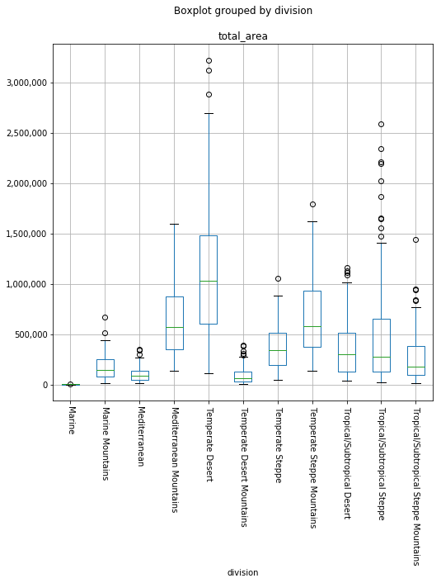
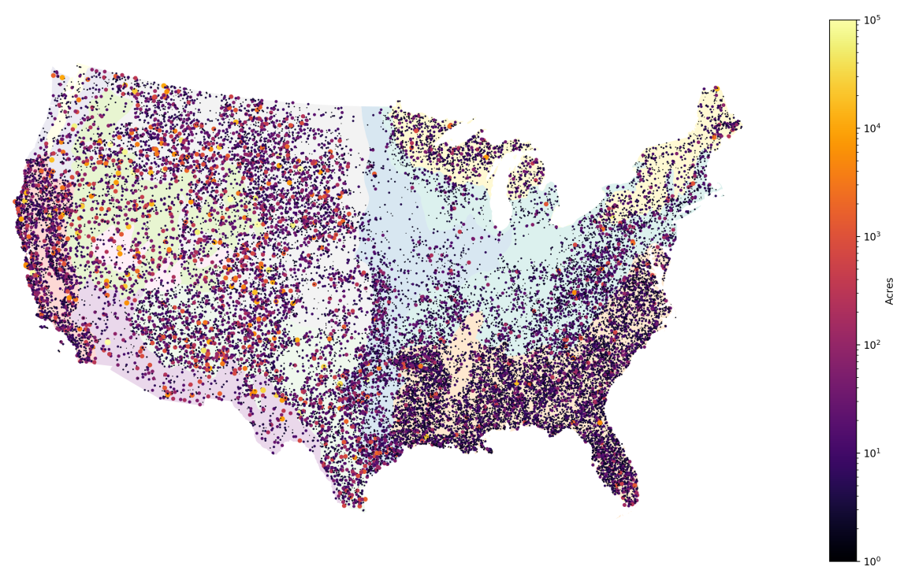
Representative Baseline Fire EI
The resulting activity dataset
reflects the variability between ecoregions
locates fires across the domain.
Baseline emissions will then be calculated from the activity data and submitted to the RH modelers.

Slide 9
Future Fire Scenarios
Future fire scenarios that aim to characterize model sensitivity to increased wildfire and Rx fire will be developed using the same methodological basis as the representative baseline inventory just described.

Slide 10
Map-based SMP Info Portal
Need: A clearinghouse location for a collection of contacts and materials related to States’ and Tribes’ Smoke Management Plans and Programs.
Method: Create a survey to gather information and link collected information to existing map on WRAP website.
Results: A clickable, geographically-based clearinghouse to quickly obtain information about SMPs in the WRAP domain.

